Slide 1



Analise Food SA
View in Power BI
Last data refresh:
30/03/2022 14:08:52 UTC
Downloaded at:
30/03/2022 19:50:04 UTC

Slide 2
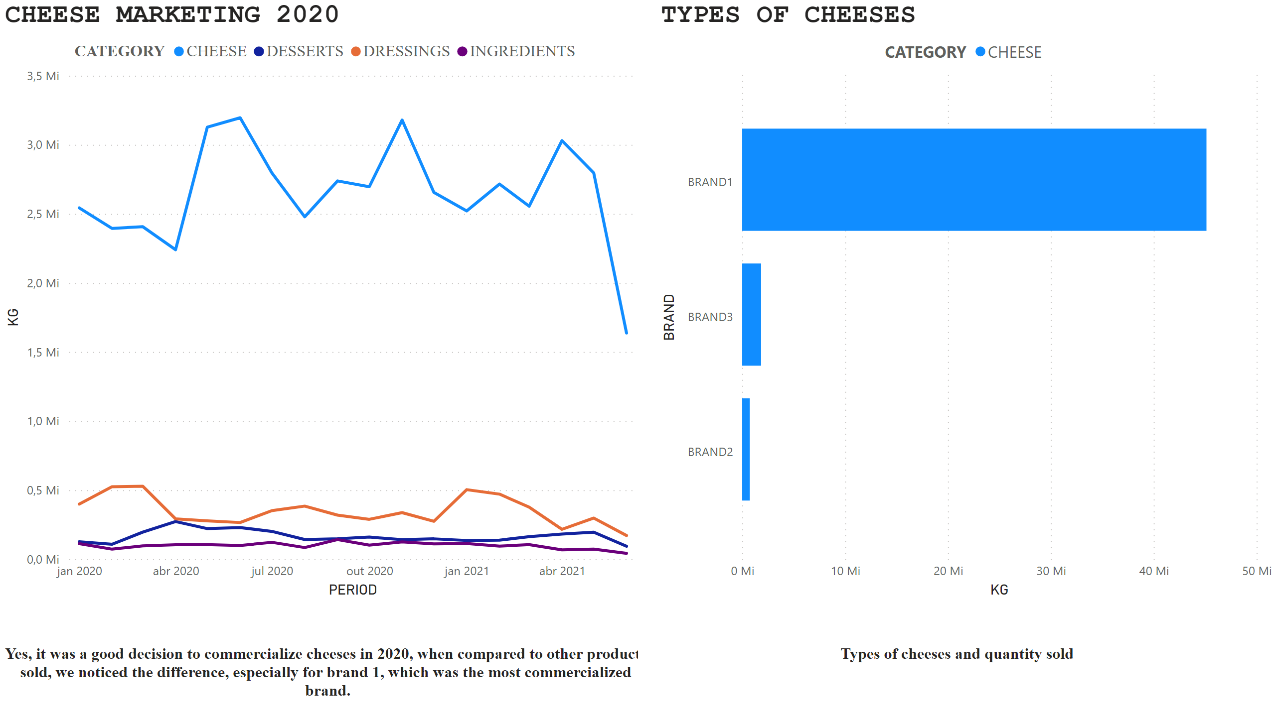
Notes:
CHEESE MARKETING 2020
No alt text provided
textbox
No alt text provided
textbox
No alt text provided
TYPES OF CHEESES
No alt text provided

Slide 3
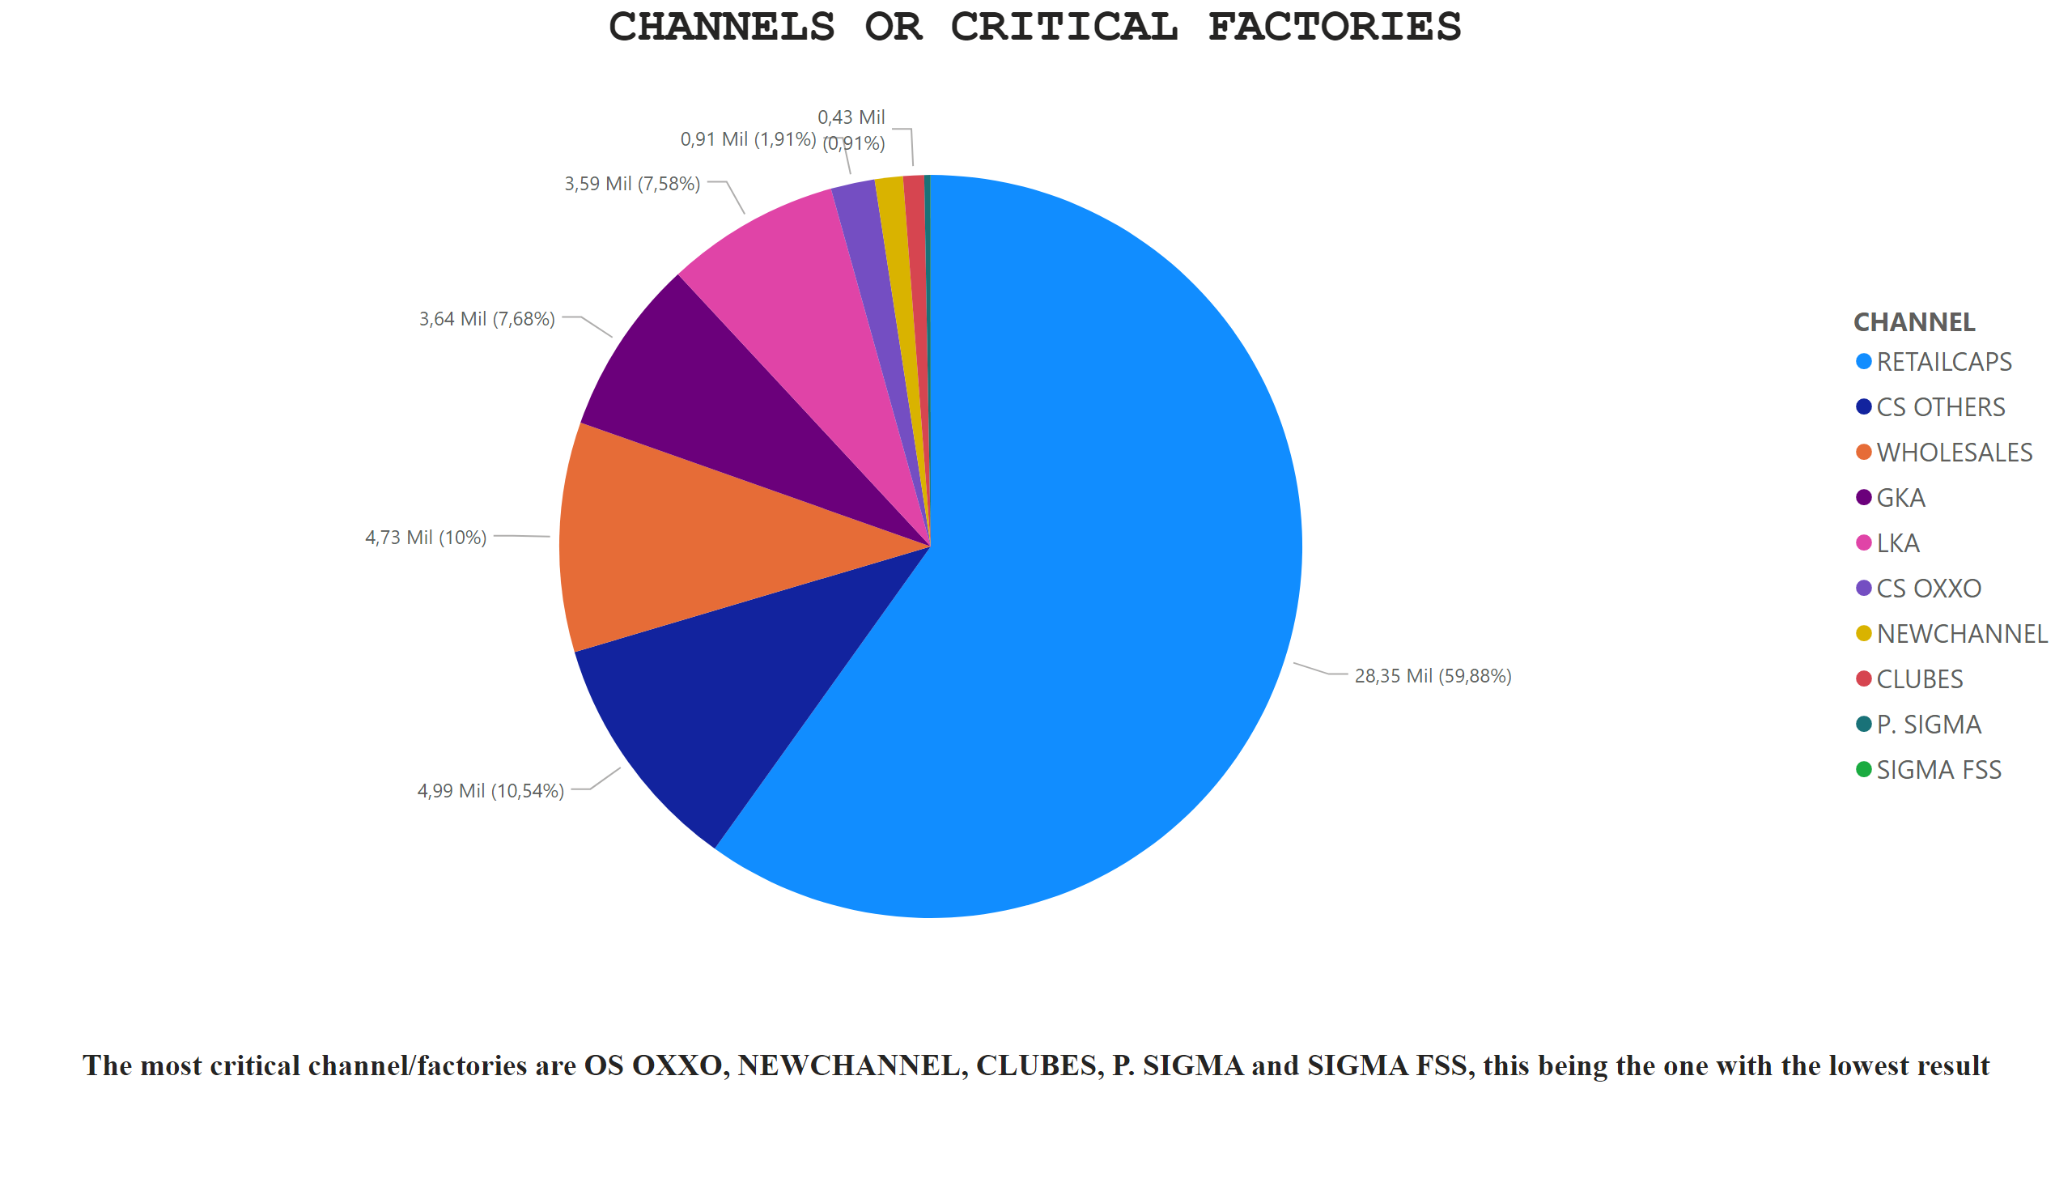
Notes:
textbox
No alt text provided
CHANNELS OR CRITICAL FACTORIES
No alt text provided

Slide 4
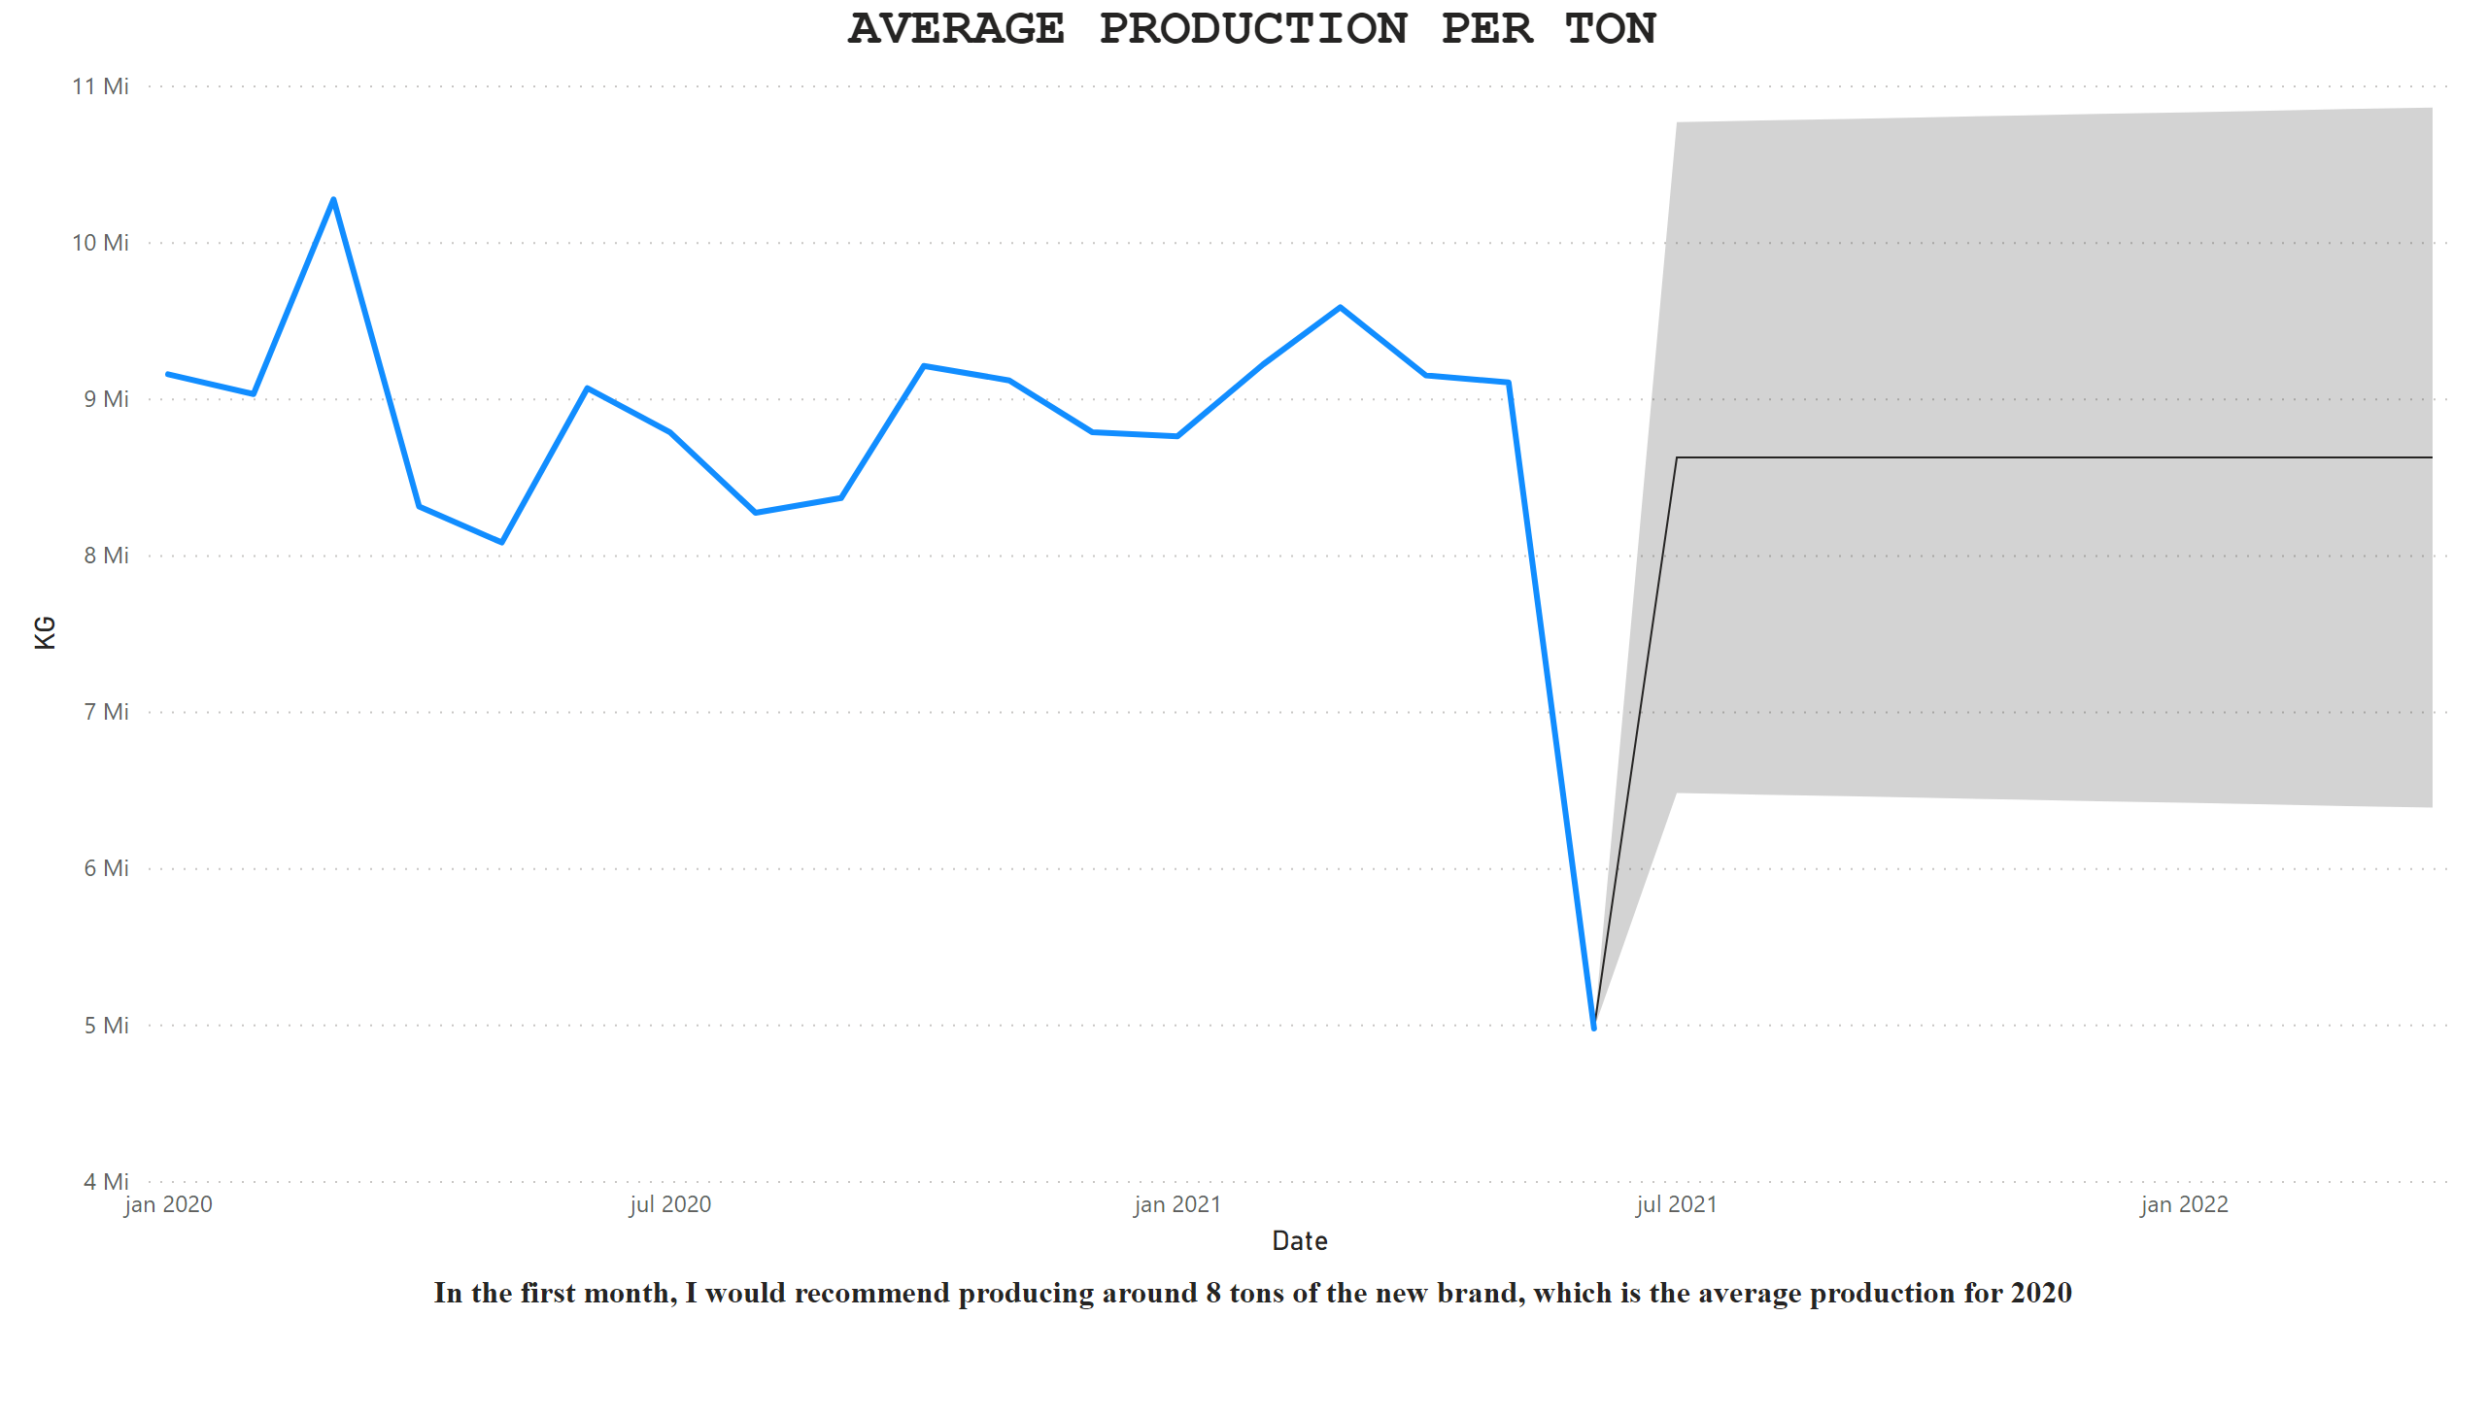
Notes:
textbox
No alt text provided
AVERAGE PRODUCTION PER TON
No alt text provided

Slide 5

PRESENTATION
The first step was a critical analysis of the data, verifying and treating the necessary points such as:
Cleaning the data
Error checking (blank spaces/cells)
In the transactions table replacing the pipe with a comma (in notepad)
Using Python to perform conversions and queries
Difficulties found
Some data didn't work in Power BI
carry out the consultation of the important mark for the most critical company
Recommend 100 or 200gr per unit
The text file with pipe (|) and white-space

